Slide 1

Kickstart Your #AdCareer:
Start an AAF College Chapter Today

Slide 2
What is the American Advertising Federation?
The AAF is “the Unifying Voice for Advertising”. Headquartered in Washington, DC, the AAF is a professional organization that represents over 40,000 members.
The AAF creates a united force in advertising by combining the strengths of major corporations, advertisers, advertising agencies, media companies, local advertising federations and college chapters.
There are currently over 200 college chapters on campuses throughout the United States.

Slide 3
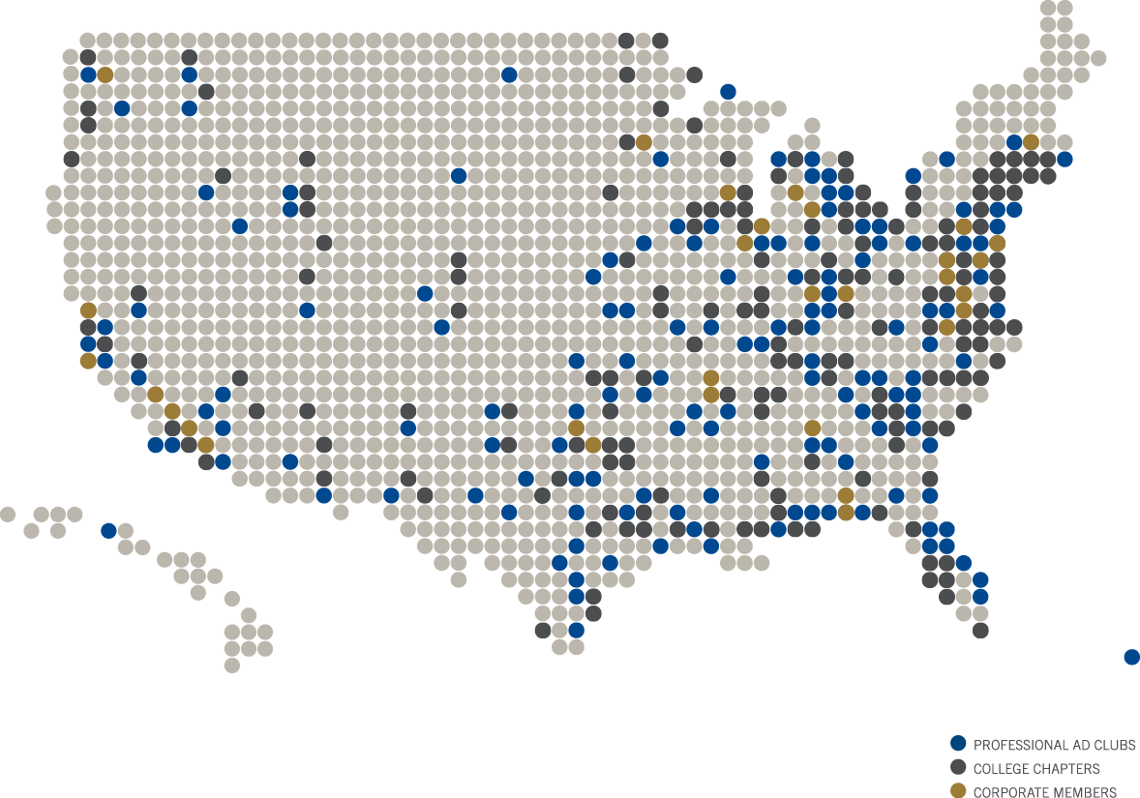
Notes:
Additional Talking Points:
Each colored dot on this map represents an AAF corporate member, college chapter or professional club. Vast membership allows the AAF to reach, engage and connect many current and aspiring ad professionals across the country.
Our college chapter network represents over 5,000 undergraduates from our 200+ AAF college chapters.

Slide 4
AAF College Chapters
AAF's college chapter program is a network of approximately 200 affiliated college chapters
  Over 5,000 undergraduate students participating
  Approximately 250 faculty advisors supporting chapter activities
  Network of industry professionals connecting with college chapters
  National Education Executive Committee governing the integrity and ethics of student programs

Slide 5
Starting a College Chapter
What you need:
10 student members
A faculty advisor
A listing of the advertising or marketing courses on your campus.
Membership dues of $55 per student
Proof that the institution of higher education is accredited
What to do:
Fill out your members’ information in the chapter roster template
Fill out the official college chapter form
Pay membership dues fee by one lump sum check or credit card
Notes:
Additional Talking Points:
To start an AAF college chapter on your campus, there are a few things you need. First, you must have a faculty advisor and at least 10 college students. Of course you can have more members but 10 students are the threshold to get your chapter off the ground. If you do not have enough members from your school, you can form a partnership with another school in your district. College chapter faculty advisors help guide the chapter and maintain it once students have graduated.
In order to hold a college chapter on campus, the AAF requires a school to offer a sequence of at least two courses in advertising or closely related topics. The school must also provide the AAF with proof that the institution of higher education is accredited by a recognized accrediting association.
After gathering everything, the elected chapter president or faculty advisor should fill out the official college chapter form, attach the chapter roster template with the participating students’ information, upload the chapter’s constitution and other supporting documents (ie. Accreditation proof) and pay the membership fee of $55 per student.

Slide 6
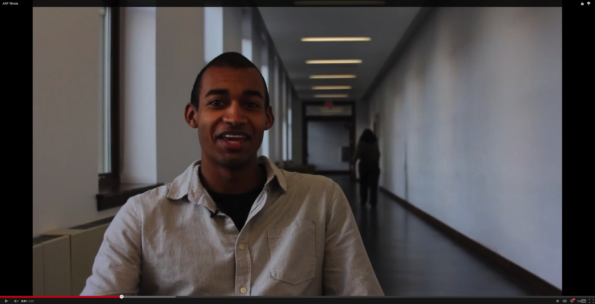
VIDEO: “AAF’s Impact on My Life”
Notes:
VIDEO: Students at the University of Illinois at Urbana-Champaign describe how their AAF college chapter has impacted their life.

Slide 7
AAF College Chapter Member Benefits
Competitions Hands-on, Practical Experience
Internships On-the-job Training
Scholarships Academic Financial Assistance
Honors and Awards Recognition for Achievements
Events Networking and Learning Opportunities
Career Resources Help to Land Your First Job
Notes:
Additional Talking Points:
The AAF Mosaic Center and Education Services department offers a broad spectrum of programming to college chapter students. From each type of programming, this is a quick snapshot of the benefits college chapter members recieve. Competitions like the National Student Advertising Competition provides hands-on experience and the chance for professional development. Events, such as our Mosaic Career Fairs, gives students the opportunity to network with top agencies and recruiters. And honors and awards programs, like Alpha Delta Sigma, recognize students for their scholastic achievement while setting them apart from every other advertising student out there. But we’ll dive deeper into each program in the next few slides….

Slide 8
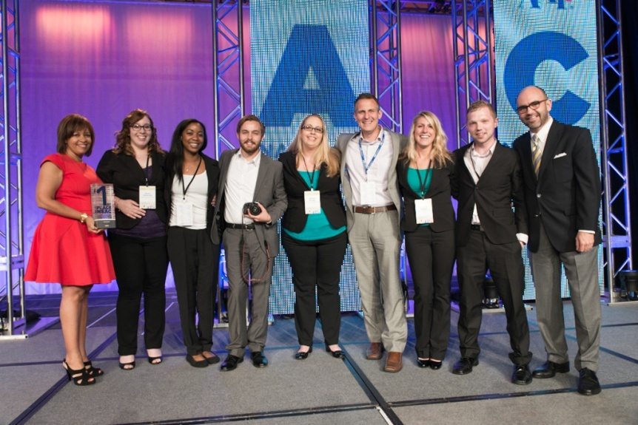
Competitions
National Student
Advertising Competition
  Design campaigns for global client brands
  Receive hands-on, practical experience
  Use Industry resources: AudienceSCAN, Experian Marketing Services,
  Kantar Media SRDS and Nielsen
  Pitch in front of seasoned advertising professionals
Student American Advertising Awards
  Compete in student version of the professional American Advertising Awards
  Gain recognition of outstanding advertising work at the local, regional and national levels
Notes:
Additional Talking Points:
The American Advertising Federation offers students two hands-on learning experiences to build their professional portfolio and be recognized for their creative work: the National Student Advertising Competition and the Student American Advertising Awards.
In the National student Advertising Competition, teams of students develop an integrated communications campaign for a corporate client, based on a real world marketing challenge. They then pitch their campaign at the District level in front of industry judges where district winners advance to semi-finals. Following the semi-finals, 8 teams from across the country vie for the national title at the AAF’s national conference, ADMERICA. Previous corporate clients include: Pizza Hut, Mary Kay, Glidden, Nissan, J.C. Penny, State Farm, AOL, Coca Cola, Yahoo!, and Hallmark.
The Student American Advertising Awards honors students’ best creative work at the local, regional and national level. Earning an ADDY award would be the equivalent/or the “likes” of receiving an Oscar at the Academy Awards for an individual's acting excellence.

Slide 9
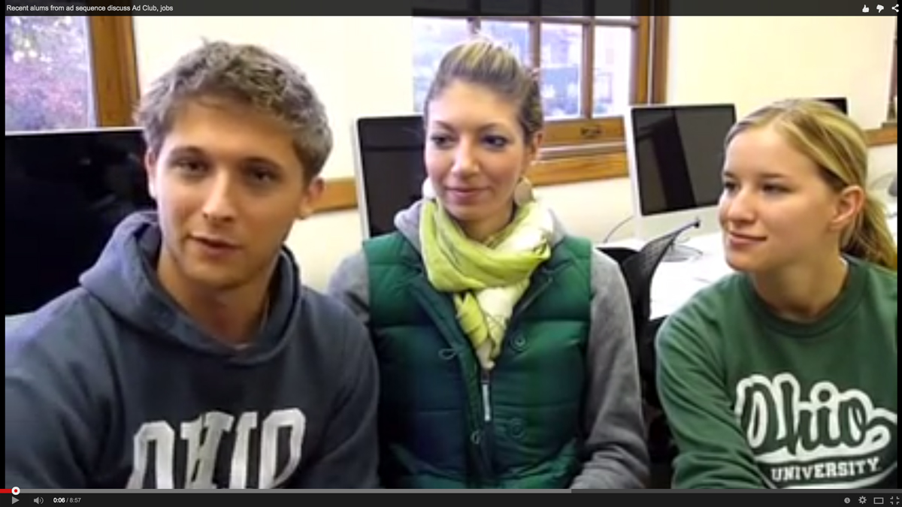
VIDEO: “My AAF College Chapter Experience”
Notes:
VIDEO: Students discuss their experiences in their AAF college chapter.

Slide 10
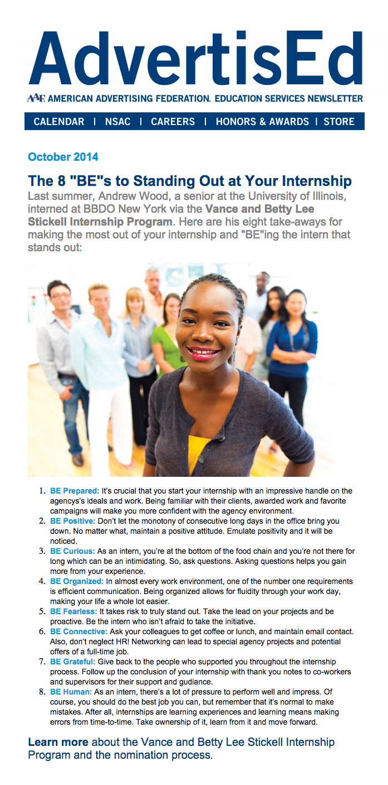
AdvertisED Newsletter
Distributed to students and faculty advisors each month
Features student articles, college chapter spotlights, career development tips, industry highlights and Mosaic Center & Education Services’ events
To see your chapter in the next newsletter, send your latest accomplishments, events or creations to mmcdaniel@aaf.org
Notes:
Additional Talking Points:
Every 2nd Monday of the month, the AAF sends out a newsletter to faculty advisors and students.
AdvertisED highlights trends happening in the ad industry and shines the spotlight on college chapters. The AAF loves to showcase the work, achievements and events of college chapters and regularly features chapters in AdvertisED and on social media.
The goal is to keep all of the student members updated on AAF education-related programs, informed about the advertising world and connected to each other.

Slide 11
Virtual Learning
Kaleidoscope: Multi-Lens Perspective on Advertising
  Advertising professionals connect with students in the college chapter network and teach them about the industry
Faculty Toolkit
  Resources from the faculty advisor community:
    Teaching tools
    Updates on the National Education Executive Committee
    Issues of Journals from Advertising Educators
    Webinar Sample Topics: crafting a winning NSAC pitch, adding value to college chapters and starting a student-run agency
Notes:
Additional Talking Points:
Throughout the year, the AAF offers various virtual learning events to our membership community through a student webinar series and the faculty toolkit. With the AAF Kaleidoscope webinar series, students are given the opportunity to connect with current ad professionals working in creative, account management and strategy about what it takes to have a successful advertising career.
Faculty advisors can also benefit from webinars, teaching tools and journals from Advertising Educators through the Faculty Toolkit resources designed by faculty members to help other advertising or marketing professors advance in their career. Faculty toolkits also include quick guides with class planning tips, creative exercise suggestions, useful reading lists, etc. Several times a year, the AAF hosts webinars on relevant topics for the faculty advisors community as well.

Slide 12
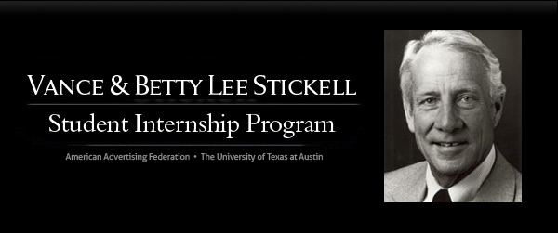
Internships
Vance and Betty Lee Stickell Student Internship
Paid 10-week summer internship program that provides future advertising professionals with real-world, hands-on experience at top agencies and companies in the industry
Stickell interns must be nominated by a faculty advisor and have attained at least junior standing by the time the internship begins
Notes:
Additional Talking Points:
The Stickell Internship program places outstanding juniors with a paid 10-week summer internship in media organizations, advertising agencies and client/supplier companies across the country. This highly competitive internship has helped more than 200 previous interns launch their advertising careers.

Slide 13


Honors and Awards
Alpha Delta Sigma Honor Society
National honor society sponsored by AAF that recognizes scholastic achievement in the study of advertising
Each year hundreds of seniors from AAF college chapters are nominated and inducted into ADS and proudly graduate wearing red and white honor cords
Diversity Achievement and Mosaic Awards (DAMA)
A new student category recognizes an outstanding student multicultural advertising campaign at the DAMA ceremony during AAF’s National Conference ADMERICA
The campaign should demonstrate the student’s understanding and sensitivity of targeted ethnic audience and their buying practices and behavior
Notes:
Additional Talking Points:
Give potential employers something to talk about by joining the only professional honor society that rewards academic excellence in the study of advertising. Every year some 500 college chapter members proudly wear Alpha Delta Sigma’s red and white honor cords while marching in their graduation ceremony.
The Diversity Achievement and Mosaic Awards recognizes the inclusion efforts of top professional, agencies and clients. Students are encouraged to submit their work into the new “student multicultural advertising campaign” category to be honored alongside professional trailblazers.

Slide 14
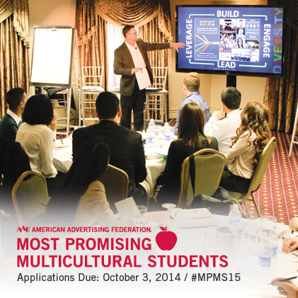
Honors and Awards
Most Promising Multicultural Students Program
Connects the advertising industry with the nation’s top multicultural college seniors
Selected students participate in a 4-day program in New York City that includes industry immersions, professional development workshops and a recruiters’ expo
Participating agencies have included:
Deutsch, Leo Burnett, Omincom Group
and Wieden + Kennedy, CNN, General Mills, FCB,
Notes:
Additional Talking Points:
Since it’s inception in 1997, the Most Promising Multicultural Students Program gives industry leaders a chance to network and recruit fresh talent while helping to bring diversity into the workplace. MPMS has helped more than 100 agencies and companies jumpstart the careers of over 600 multicultural professionals. During the 4-day experience in New York, students participate in leadership development, agency visits and also attend a Broadway play! MPMS students have the chance to experience NYC and often leave the program with job offers in hand!

Slide 15
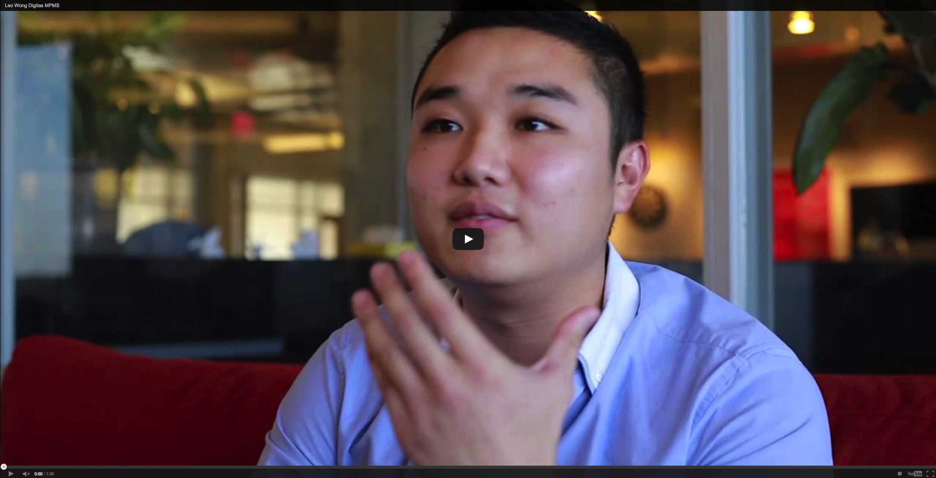
VIDEO: “How MPMS Jumpstarted my Career”
Notes:
VIDEO: MPMS alum, Leo Wong, discusses how the MPMS program helped him jumpstart his career.

Slide 16
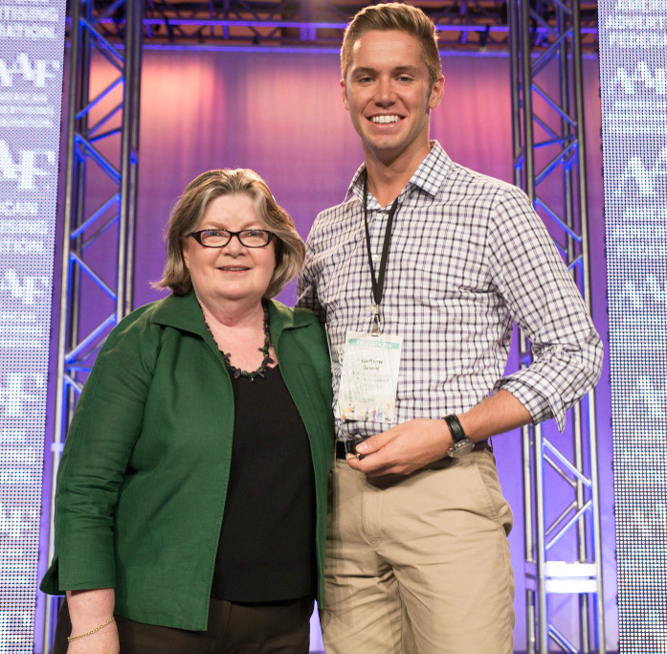
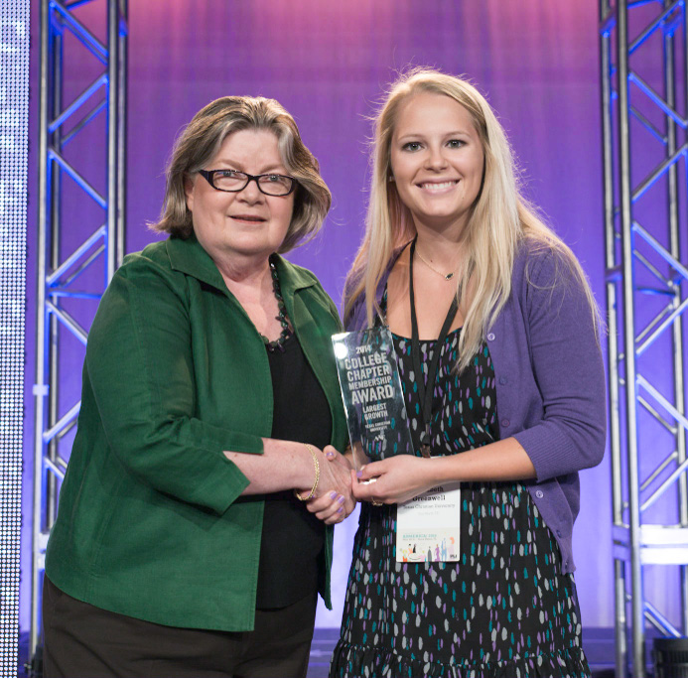
College Chapter Membership Contest
Largest Total Chapter Membership
Largest Chapter Membership Growth
Notes:
Additional Talking Points:
AAF college chapter contests recognizes two college chapters each year for outstanding membership (largest chapter and largest growth). Each winning college chapter will receive an award and a complimentary free trip (including airfare and hotel accommodations) to our annual national conference, ADMERICA.

Slide 17


Events
Mosaic Career Fairs
  Resume reviews, portfolio critiques, professional development seminars and panel discussions
    New York City: FCB Mosaic Career Fair
    Chicago: Leo Burnett Mosaic Career Fair
Insight/Interaction: Student Conference on Advertising
  Professional development opportunities
  Industry networking
  Advertising industry market news and trends
  Recruiters’ Expo
Notes:
Additional Talking Points:
The Mosaic Career Fairs give college students the opportunity to learn about internships and career opportunities from recruiters representing some of the nation’s top advertising, marketing and communications companies.
Every fall the American Advertising Federation kicks off the academic year with a 2-day student conference in Washington, DC in October. Besides interacting with fellow college chapter members from around the country and learning tips on running a successful chapter, students partake in professional development workshops, discover the latest trends in the advertising industry and learn more about career opportunities in the field through industry immersions and a recruiters’ expo.

Slide 18
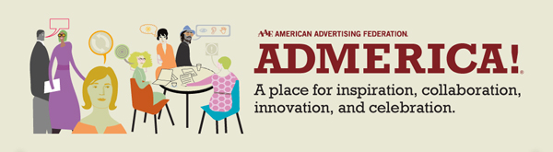
Events, continued
ADMERICA, AAF’s National Conference
  Provides a forum for all issues that concern constituents of the advertising industry
  Networking with over 1,000 advertising professionals from local and national advertising agencies, client companies and media companies
  Activities include influential keynote speakers, professional development workshops, club management workshops and peer relationship building
Notes:
Additional Talking Points:
AAF’s annual ADMERICA conference is a great way for students to network with industry professionals from all over the country. With many professional development sessions, speakers and social events, ADMERICA is just an added benefit for student members. Also, the final round of the National Student Advertising Competition Finals are held during this conference.

Slide 19
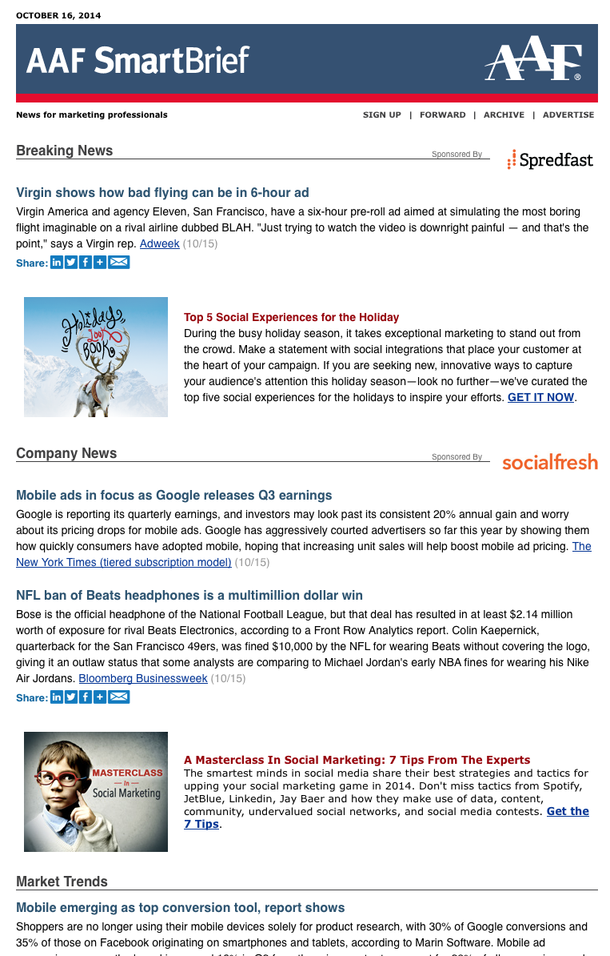
Career Resources
AAF Job Bank
  Offers hundreds of active advertising and communications jobs and internships from over 800 registered employers
AAF SmartBrief
  Summarizes advertising news that really matters into one source for students to keep abreast on industry and market trends
Notes:
Additional Talking Points:
AAF Job Bank offers specific advertising and marketing jobs exclusively to our AAF college chapter members. These job opportunities originate from their extensive corporate member base with over 800 registered employers. And is a free service to you as a member.
AAF SmartBrief is the easiest way for college chapter students to stay up-to-date with what’s happening in the ad industry. This daily email synthesizes all the industry news and sends it to your inbox each morning.

Slide 20

Post College
Ad 2
  National network of local advertising federations whose members are age 32 and younger
  Gives young professionals a chance to interact with their peers and help bridge the gap between college graduation and entry into the professional world by providing professional development and public service programs
  Ad 2 has 25 clubs, representing over 1,000 members
Professional Ad Clubs
  Ad Clubs offer benefits in addition to the national membership opportunities and have a separate fee structure
Notes:
Additional Talking Points:
Your involvement with the AAF doesn’t have to end after your college chapter membership expires! Here are resources for you after graduation. Ad 2 is the perfect way to transition from college chapter member to industry professional.
The AAF also has 180 professional Ad Clubs that are a great way for students to network and stay involved with AAF once they leave their college chapter. And most Ad Clubs offer special rates for students when they join their local chapter.

Slide 21
Notes:
Additional Talking Points:
Just to summarize, the AAF offers a multitude of programming – NSAC, MPMS, Stickell, ADS - to help you build a successful career in the advertising business. We hope you will join our network of over 200+ college chapters across the country.
You can start a college chapter in these simple steps.
1. Find a faculty advisor for your chapter
2. Gather up 10 students
3. Fill out the official college chapter membership form
4. Upload all the appropriate documents (constitution, accreditation proof and chapter roster)
5. Pay membership dues of $55 per student

Slide 22
Mosaic Center & Education Services
Melissa Wong: mwong@aaf.org
Assistant Vice President, Mosaic Center and Education Services
Kai Jones: kjones@aaf.org
Program Manager, Mosaic Center and Education Services
Laetitia Brock: lbrock@aaf.org
Program Manager, Mosaic Center and Education Services
Morgan McDaniel: mmcdaniel@aaf.org
Assistant Program Manager, Mosaic Center and Education Services
Email: education@aaf.org
Twitter: @AAF_ED
Facebook: AAFEducation
Notes:
Feel free to contact the AAF Mosaic Center and Education Services team with any questions and also add their social media pages to your network!

Slide 23
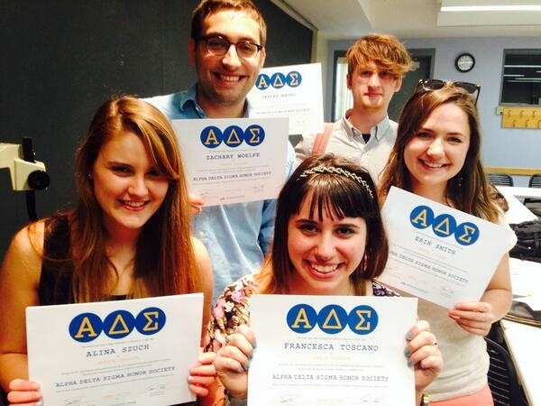
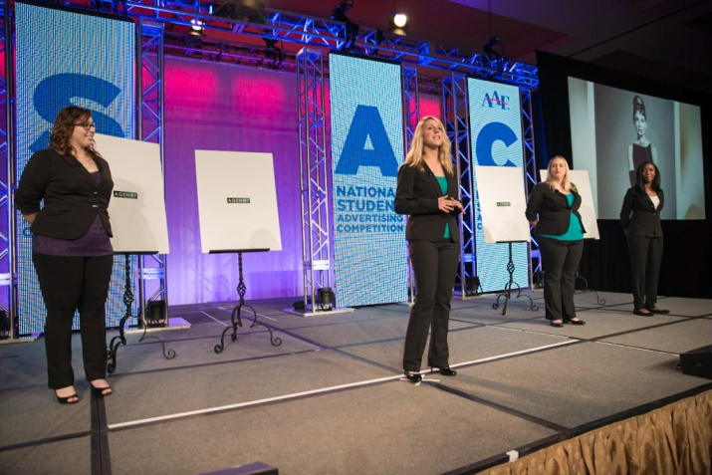
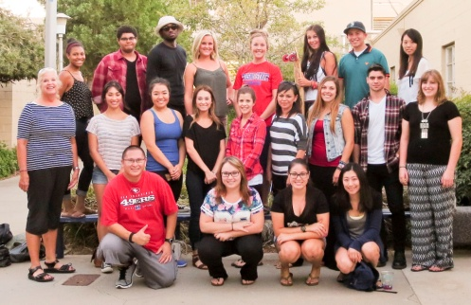
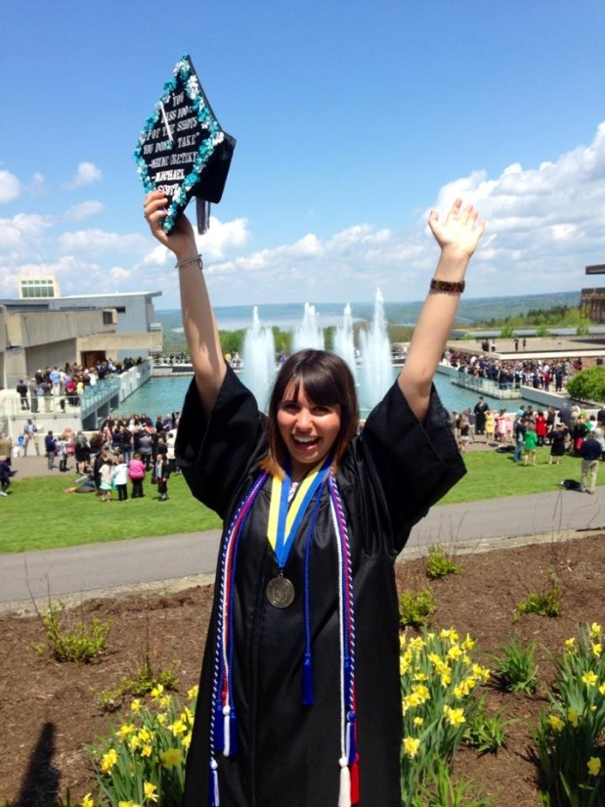
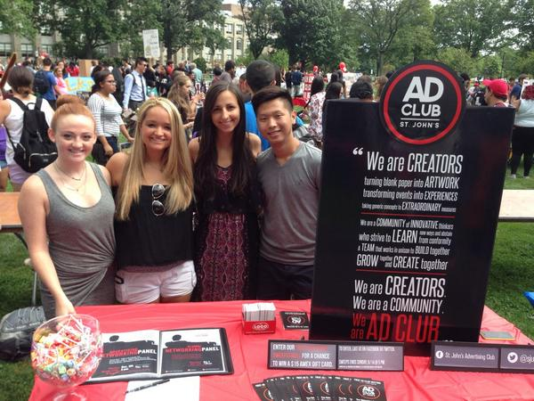
Start your AAF Experience Today!
Notes:
Hope to see an AAF college chapter on your campus soon!

